Slide 1
Zimbabwe Viral Load Clinic: Laboratory Interface Webinar
10 October 2019

Slide 2
Objectives of Webinar
Sensitise all stakeholders on the CLI
Provide adequate guidance on the implementation model
Begin the planning and preparation for the implementation of the project

Slide 3
Agenda
Time | Topic | Facilitator
1400-1410 | Introductions | Dr Chiedza Mupanguri
1410-1440 | Zimbabwe VL update and CLI initiative | Dr Bekezela Khabo
1440-1450 | Discussion
1450-1500 | Pepfar Update | Takudzwa Machirori
1500-1545 | LARC | Dr Barbara McKinney and Katy Yao
1545-1600 | Discussion and next steps | Dr Bekezela Khabo

Slide 4
Outline
Epidemiology of HIV in Zimbabwe
Evolution of ART Provision in Zimbabwe
Viral load background in Zimbabwe
Progress Made and Challenges in viral Load Services
Clinical: Laboratory Interphase Update

Slide 5
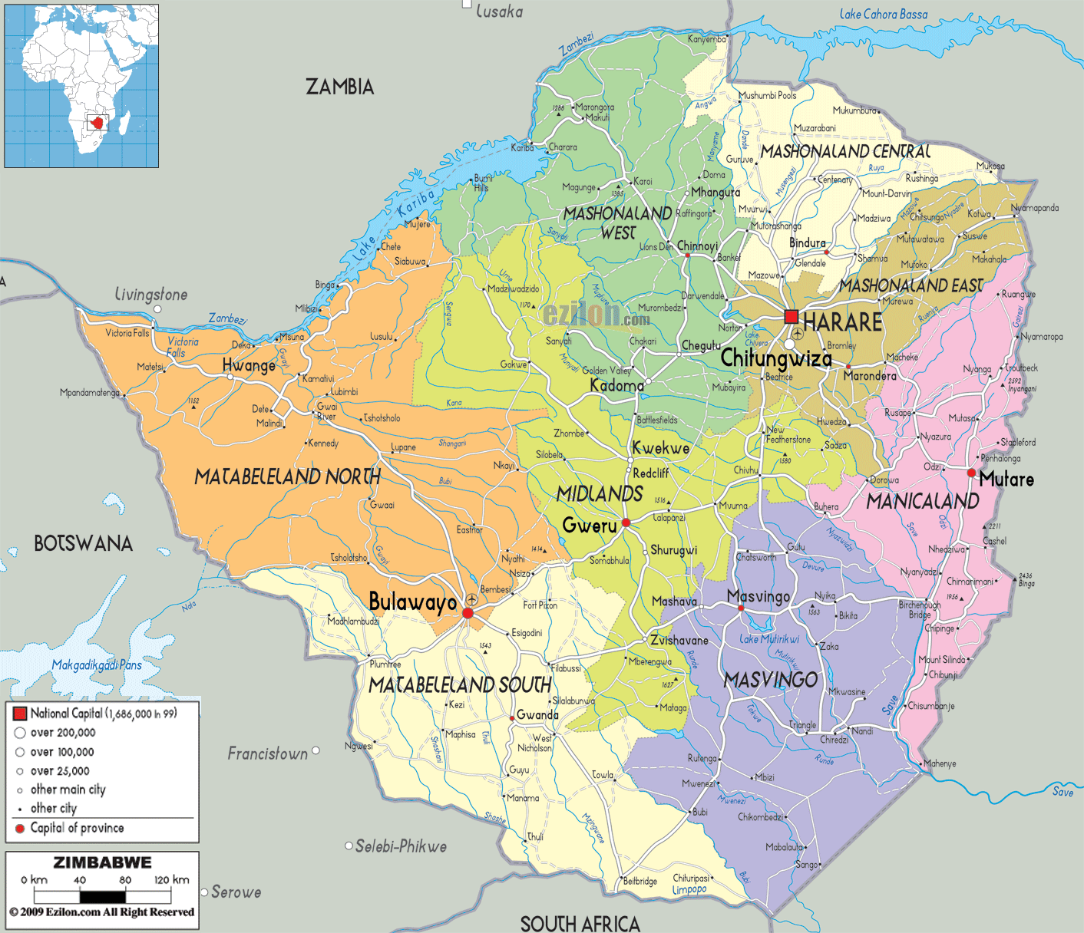
Country Context:
Zimbabwe remain one of the countries in the world heavily burdened by HIV/AIDS & TB
  1.3m PLHIV
    1,25m adults
    76,592 children
  (2017 HIV estimates)
  HIV Prevalence: 13.7% among 15-49 yr age group
    Female 16.7%
    Male 10.5%
  HIV Incidence: 0.48% in 2016 (down from 1.42% in 2011, 0.98% in 2013)
  (ZIMPHIA, 2016)
  MTCT rate 6.7%
  (2017 HIV estimates)
  TB/HIV co-infectivity rate of 63% [Global TB Report, 2018]
Total Popn ~ 13 million (2012 Census)
Notes:
Zimbabwe has a projected population of 13m people and is among the countries in Sub-Saharan
Africa worst affected by the HIV

Slide 6
HIV services have significantly been decentralised since program inception which has brought services closer to those who need them….
Health facilities offering HIV Services as @ June 2019
Major Partnerships: NAC, PEPFAR( USAID, CDC), GF, DFID, JSI , WHO, UNICEF, UNAIDS, MSF, CHAI
Source-DHIS2
Notes:
This graph shows health facilities offering HIV services in Zimbabwe as at June 2018. 85% (n=1588) of these sites offer both adult and paediatric ART. While we note with some concern that uptake of IPT is low, IPT coverage is relatively fair, standing at 73% in Zimbabwe. There is therefore potential to improve IPT coverage
Out of 1588 sites, 39% (n=624), have ePMS installed in them.
While we note that these sites are high volume sites, we may need as a program to be proactive in looking for opportunities to scale up ePMS coverage to approximately 3/5 of the facilities where ePMS is not installed. In the medium term we may need to operationalise roving DECs concept to capture all HIV data particularly in sites with low coverage of HIV ePMS

Slide 7
Adults Estimated 90-90-90 Estimated Progress
Progress towards targets
Children Estimated 90-90-90 Estimated Progress
Source: Draft Shiny 90, 2018 HIV Estimates

Slide 8
Evolution of the OI/ART Programme, 2004 - 2018
Addendum to the 2016 National ART Guidelines
2016 National ART Guidelines
2013 National ART Guidelines
2010 National ART Guidelines
Country introduced OI/ART programme in April 2004 guided by
  Nationwide Scale-up of ART plans covering periods 2005-2007; 2008 – 2012 & 2013 – 2017,
  Plan feeds into overarching extended Zimbabwe National AIDS Strategic Plans (ZNASP), coordinated by one coordinating body (NAC) and monitored by one monitoring framework – The ‘Three Ones Principle‘

Slide 9
Clients on ART (Adults & Children) by regimen as @ Dec 2018
Output | Primary Care level | District / Mission Hospitals | Provincial Hospitals | Central Hospitals | Total
Total HIV pts in Care | 926,711 | 206,381 | 26,018 | 22,022 | 1,181,132
Number on ART | 902,347 | 200,955 | 25,334 | 21,443 | 1,150,079
Number Newly initiated on ART | 106,266 | 15,332 | 2,180 | 2,990 | 126,768
Number of patients on:
First line | 873,334 | 190,169 | 23,655 | 19,005 | 1,106,163
Second line | 29,011 | 10,739 | 1,678 | 2,286 | 43,714
Third line | 0 | 111 | 0 | 91 | 202

Slide 10
Viral Load Testing Coverage, 2015 - 2018

Slide 11
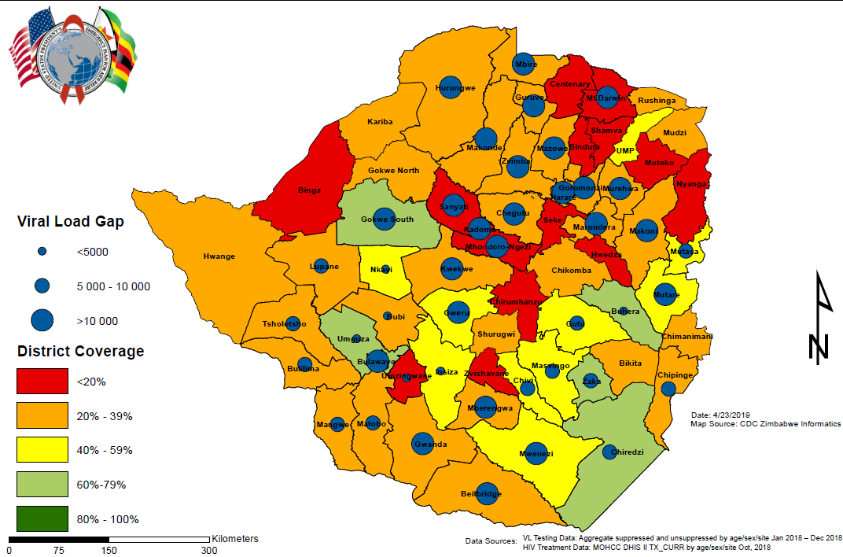
What does our gap to VL coverage look like?
Coverage Vs Testing Gap
All-Age, Sex
Notes:
To select high gap districts for lab clinic interphase strengthening activities so that resources are directed to areas of greatest need and lowest coverage as a subset of total patients on art.
Optimized integrated sample transport system in high gap (>10,000) to improve access, coverage and quality of care

Slide 12
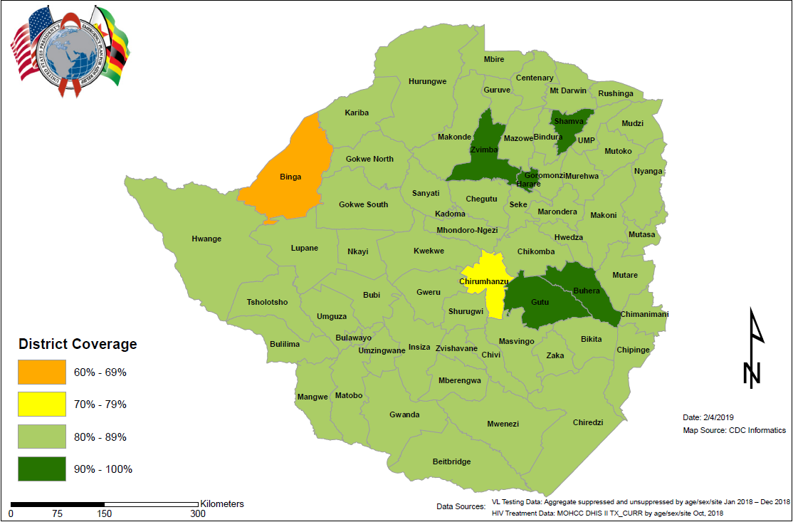
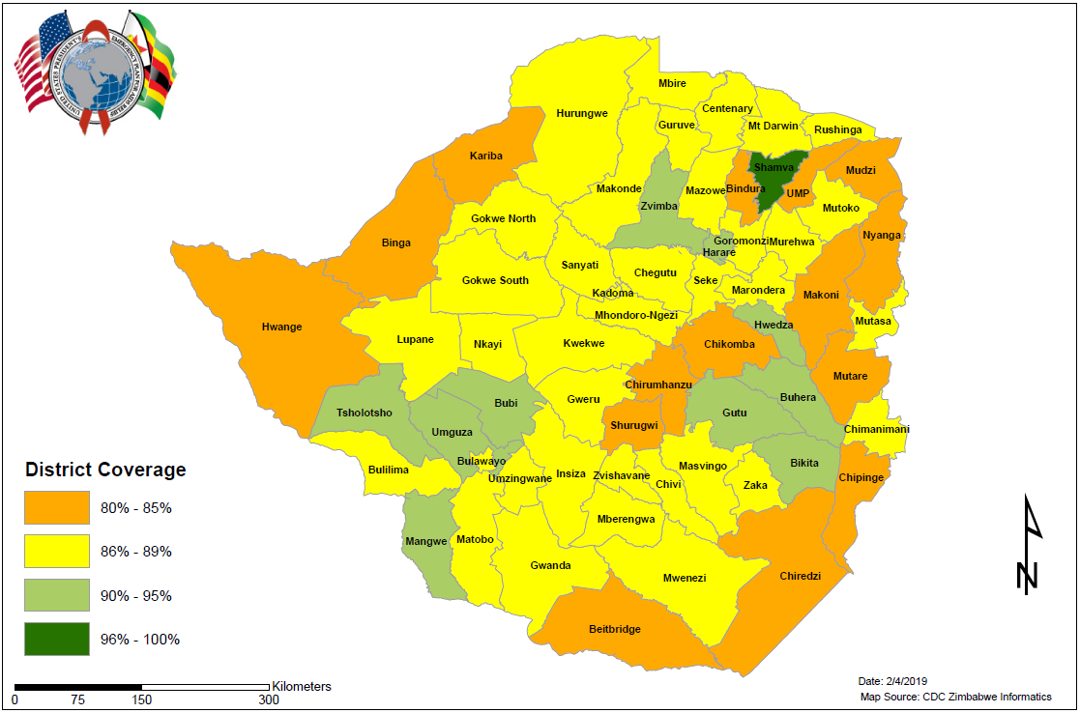
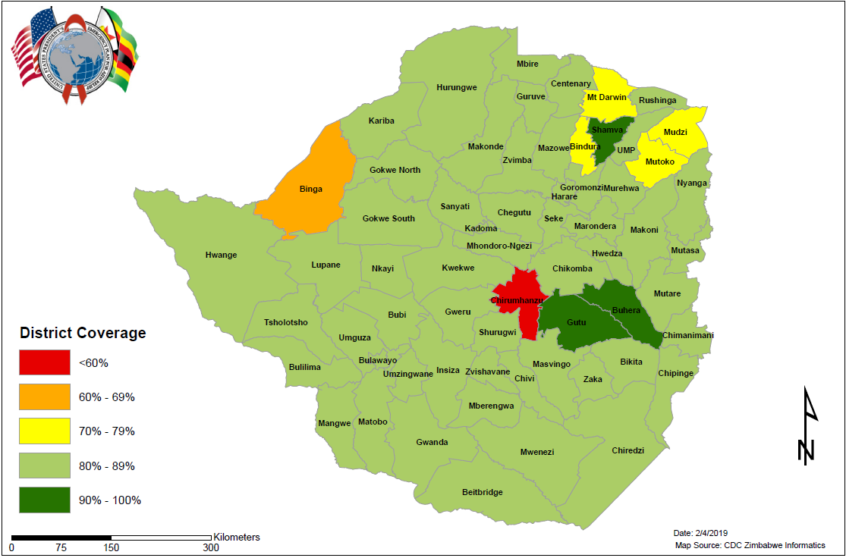
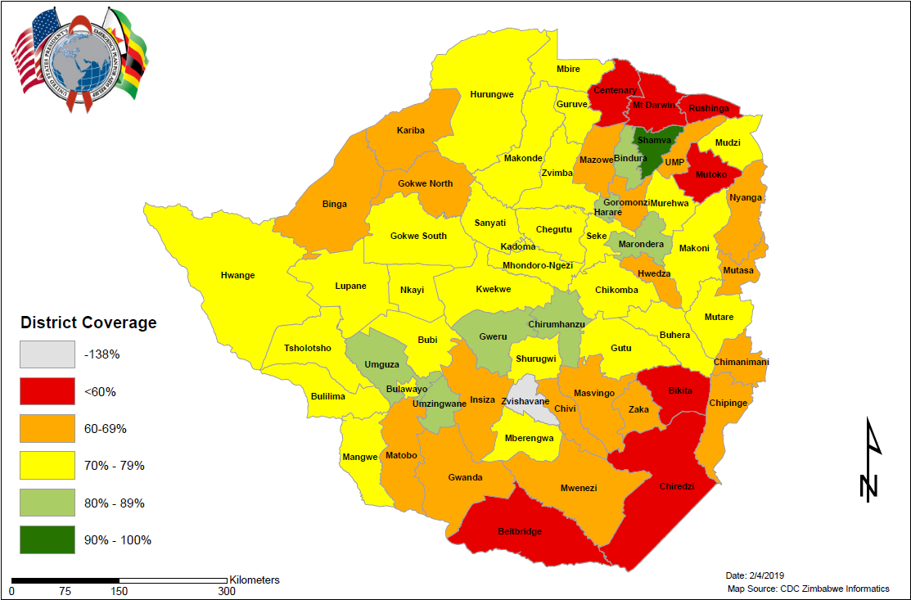
Suppression
Suppression
All-Age, Sex
Adult Male
Suppression
Suppression
Adult Female
Pediatrics
Notes:
District Suppression Maps

Slide 13
2018 Viral Suppression by Province

Slide 14
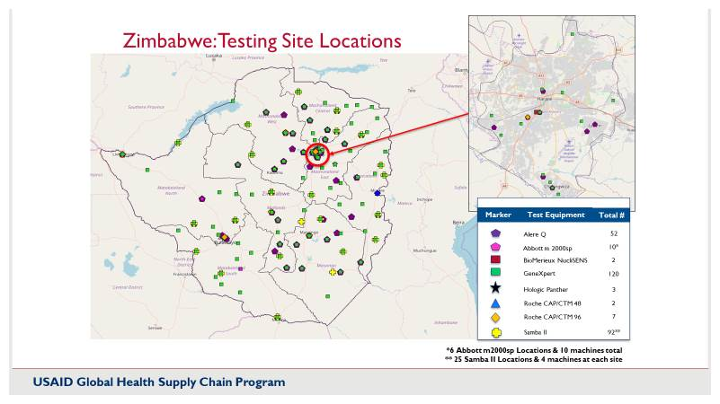

Slide 15
VL testing Lab | Instrument Type | Total number of instrument | Capacity/ instrument | Total capacity
Beat AIDS | Roche Cobas CAP/CTM96 | 1 | 44,352 | 44,352
Beatrice Road Infectious Disease Hospital | BM NucliSens Easy Q HIV-1 v 2.0 | 1 | 39,600 | 39,600
 | Roche Cobas CAP/CTM96 | 1 | 44,352 | 44,352
Chinhoyi Provincial | Roche Cobas CAP/CTM96 | 1 | 44,352 | 44,352
Chitungwiza (PSI) | Abbott m2000 | 1 | 31,680 | 31,680
Gweru Provincial Hospital | Roche Cobas CAP/CTM96 | 1 | 44,352 | 44,352
Masvingo Provincial Hosp. | Roche Cobas CAP/CTM 96 | 1 | 44,352 | 44,352
Mpilo Central Hospital | Roche Cobas CAP/CTM96 | 1 | 44,352 | 44,352
 | Abbott m2000 | 2 | 31,680 | 63,360
Mutare Provincial Hospital | Roche Cobas CAP/CTM96 | 1 | 44,352 | 44,352
 | Abbott m2000 | 2 | 31,680 | 63,360
NMRL | BM NucliSens Easy Q HIV-1 v 2.0 | 1 | 39,600 | 39,600
 | Abbott m2000 | 3 | 31,680 | 95,040
Gwanda and St. Luke’s Hospitals | Abbott m2000 | 2 | 31,680 | 63,360
Bindura, Kadoma, Marondera | Hologic Panther | 3 | 66000 | 198000
Various districts | Samba | 100 |  | 79200
Total Annual 8 hr capacity |  |  |  | 983,664

Slide 16
Viral Load scale up in Zimbabwe
Achievements
Viral load scale up Plan revised with following targets
2018 60%
2019 80%
2020 95%
Integrated Sample Transportation
-Costed Plan available and
currently resource mobilisation
The country now has a total of 22 conventional machines and 100 POC Samba machines
Viral load bundling
Challenges
Sub-optimal LIMS
Weak Sample transportation
Long TAT and inadequate systems to track TAT
No VL dashboard to track program progress
Inadequate laboratory Staff( Lab scientists and data entry clerks)
Inadequate utilisation of high viral load results by HCW

Slide 17
Management of PLHIV enrolled in ART care with High Viral Load in the Zimbabwe ART Program, 2004-2017
Leakages along the VL care cascade
840,971 patients entered in the ePMS
721,514 (85.8%) never had a VL done
119,457 (14.2%) ever had a VL done
96,754 (81%) have VL<1,000
22,703 (19%) have VL ≥1,000
7,764 (34.2%) had a follow-up VL done
3,076 (39.6%) had 2nd VL<1,000
4,688 (60.4%) had 2nd VL ≥1,000
1,991 (42.5%) switched to 2nd-line ART
85.8%
65.8%
57.5%
Source: ePMS Report, 2018
Missed opportunities in actioning on unsuppressed VL result reaching the 3rd 90
Unavailability of resistance testing with most clients accessing service from private sector (US$200 – US$700/test
Limited 3rd line options due to unavailability of single formulations of NRTIs

Slide 18
Bottlenecks to VL Scale up
HRH
Integrated Sample Transport
Inadequate staff Lab Scientists and Data clerks
Inadequate Funding to support optimal IST
Poor VL Result utilization
Sub-optimal data management
Inadequate utilization of High VL results
Inadequate result transmission and tracking system and documentation
Demand creation
VL Reagent funding
Poor systems to identify and ensure VL tests are requested
Inadequate VL reagent funding

Slide 19
Introducing the VL CLI Initiative
Viral Load QI project

Slide 20
National CLI Project Aim
To improve VL Coverage of PLHIV on ART at participating facilities, improve VL result utilization incl optimal VL suppression and switching of clients with drug-resistance to second line
To improve overall TAT, and lab rejection rates.

Slide 21
Objectives- facilities
Increase 12month VL coverage among PLHIV on ART from current 44% to 95% by end of 2020 at participating facilities, and
To increase proportion of clients with high initial VL managed according to guidelines at participating health facilities from baseline to 90% by end of 2020.

Slide 22
Objectives- laboratory
Reduce intra-lab turnaround time for VL from current 28days to 7days by the end of 2020;
Reducing sample rejection rates at VL testing labs in Zimbabwe from current 2% to <1% by end of 2020.

Slide 23
Objective- Interface
To reduce the total TAT of VL testing from current baseline to 14days

Slide 24
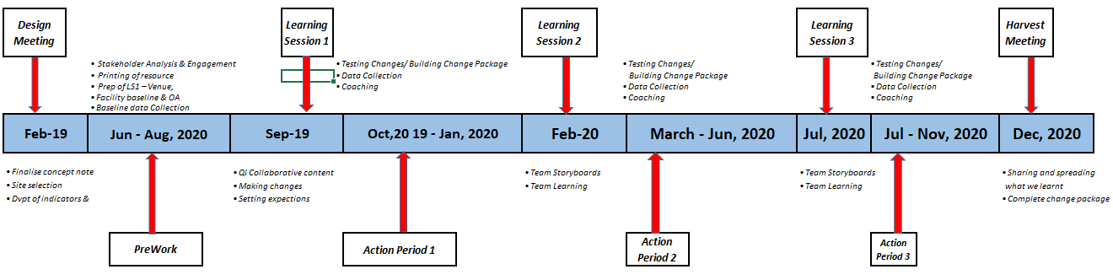
CQI VL Roadmap

Slide 25
VL QI districts
PEPFAR Supported districts
  10districts -FHI, ITECH, OPHID, PSI, ZACH
  50 on CDC
  56 on USAID
Non – Pepfar districts
  Mutoko (Mash East)
  Bindura (Mash Central)
  Shamva (Mash Central)
  Zvishavane (Midlands)
  Binga (Mat North)
  25 facilities in total
Plus all VL Labs

Slide 26
Performance metrics

Slide 27
CQI VL - Facility Indicators
Proportion of PLHIV newly initiated on ART that received a viral load test 6 months after initiation
Proportion of PLHIV and on ART at the facility who had a VL test done in the past 12 months (VL Coverage) - disaggregated by age, sex, pregnancy status, DSD model
Proportion of PLHIV and on ART who had a VL test done within 6months of ART initiation and are virally suppressed (less than 1000 copies/ml)
Proportion of PLHIV and on ART who had a VL test done and are virally suppressed(less than 1000 copies/ml)
Proportion of PLHIV and on ART who had a high viral load who completed EAC sessions within three months of receipt of high VL result
Proportion of PLHIV and on ART who had a high viral load who received a repeat VL after completing EAC sessions within a month
Proportion of PLHIV and on ART who are not virally suppressed after the second VL who are switched to second line ART

Slide 28
CQI VL - Lab Interface Indicators
Proportion of VL results processed within the specified TAT (14days)
Proportion of VL tests rejected by each lab
%age capacity utilisation of VL machine(s)
Proportion of sites in the lab/specimen transport network that is submitting samples for routine VL testing
Commodities Stockout
Proportion of machines operating time lost due to machine downtime

Slide 29
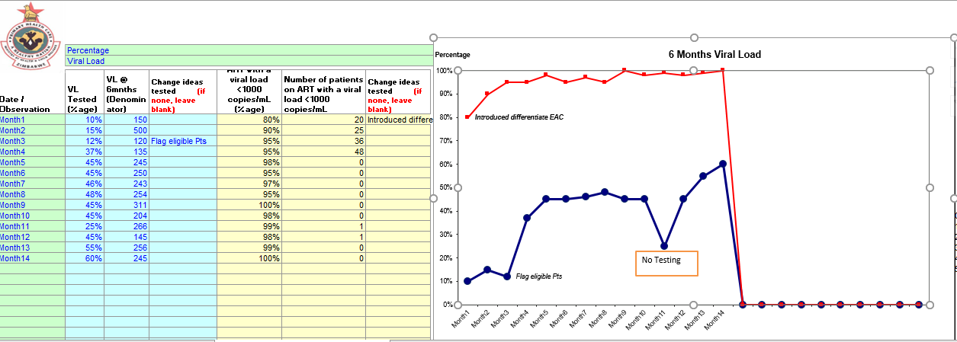
Sample Run charts 6 Months Viral Load

Slide 30
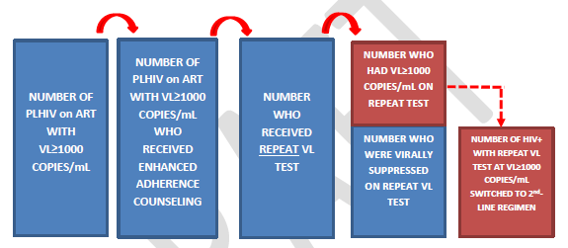
Example:Cascade for Patients whose initial VL test result VL>1000 copies/mL

Slide 31
LARC (Laboratory African Regional Collaborative)
Technical Support for the implementation of VL CLI Collaborative- learning collaborative initiative designed to enhance HIV service delivery by facilitating multidisciplinary teamwork in health facilities and laboratories using the continuous quality improvement (CQI)
Program purpose:
  To strengthen the laboratory-clinic interface across the viral load cascade in order to achieve better patient results (i.e., viral load suppression) using proven CQI methodologies and tools
  To improve institutional capacity and effectiveness through training, mentoring, and enhanced inter-cadre collaboration and communication.
  More in the next presentation…

Slide 32
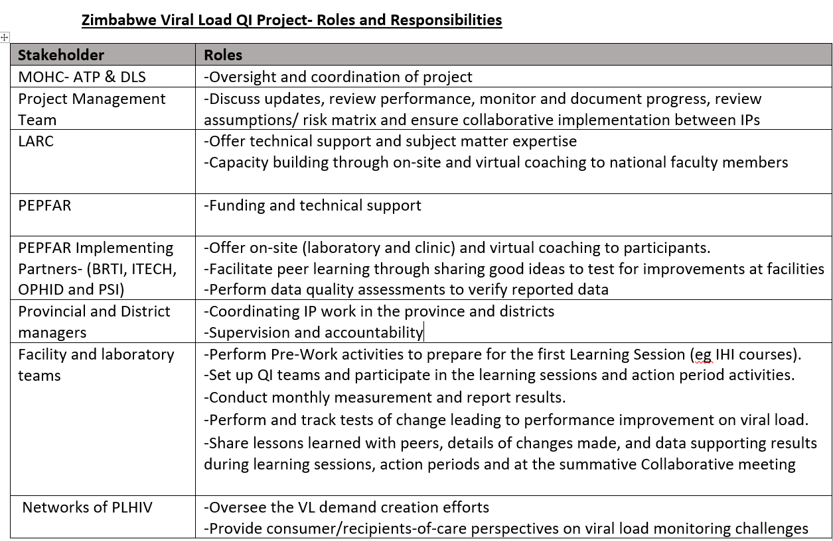

Slide 33
Next Steps From Webinar
    Issuing of IHI Scholarships, and taking of mandatory Courses before 21 October 2019 by phase1
    Finalize VL CLI roles and responsibilities
    Pilot of data collection and reporting tools
    Meeting with the faculty and national trainers on 21st October
    Smart Starts and Learning Sessions for northern region
    Replicate Smart Starts and Learning Sessions for southern region
    Testing of changes by facility and laboratory teams supported by coaches
    Monthly reporting and documentation
    Rapid rollout of participating facilities and laboratories over the coming year in subsequent Learning Sessions
    Development of final report and Change Package for the initiative

Slide 34
Thank you

